Slide 1
Dr. Buddha Dev Biswas Department of Social Science
Migration in Bangladesh

Slide 2
Contents
Definition
Types
Causes of Internal(Rural-Urban) Migration
In Bangladesh
Effects or consequences of Rural-Urban Migration
How to reduce the internal migration

Slide 3
Migration: Definition
The temporary or permanent movement of people from one place to another.
“Migration refers to movement of a person from one place to another place, away from native place either within or outside the country for job, occupation, business or in search of better standard of living, on a permanent basis.”

Slide 4
Immigration and Emigration:
When people from one country move permanently to another country, for example, if people from Bangladesh move to America then for America, it is termed as Immigration, whereas for Bangladesh it is termed as Emigration.

Slide 5
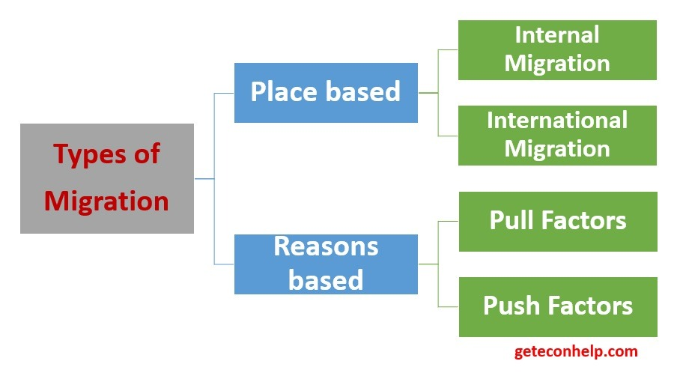
Types of Migration

Slide 6
Types of Migration
There are many types of migrations and many people are not aware of these types. Below we have discussed the most common ones:
Internal Migration: It is the type in which you move to a new home within the same state, country or continent. A person move to another administrative territory.
Rural-Urban Migration :Movement of people away from the rural region (countryside, farms) to an urban (town, city) area.
External/International Migration: It is the type in which you move to a new home in a different state, country or continent.

Slide 7
International Migration
Population Transfer/Forced Migration: It is the type in which the government forces a huge group of people to leave a region on the basis of religion or ethnicity. It is also called the involuntary or the forced migration. Refugees are persons who owing to well-founded fear of persecution for reasons of race, religion, nationality or political opinions, are outside of their country of origin and cannot or owing to such fear, do not wish to avail themselves of the protection of that country.
Impelled/Imposed: It is the type of movement in which people are forced to leave a country because of unfavorable situations like religious persecution, political unrest or warfare.
Return Migration: It is the voluntary movement of the immigrants to the place of origin.
Seasonal Migration: It is the movement for a specific period of time in response to the climate conditions or labor conditions.
Chain Migration: It is the type of movement which begins from one member of the family who arranges money for his family members in order to make them move to a new location.

Slide 8
Internal Migration in Bangladesh
Rural-urban migration plays a key role in the rapid urbanization process of Bangladesh. Increasing urbanization is not caused by the natural population growth in the urban areas in Bangladesh; rather it is an outcome of the push - pull factors of migration.

Slide 9
Causes of Migration(Push-Pull Factors)Rural-Urban in Bangladesh
Push factors:
These are the negative factors in the home country that compel people to move to another one.
Push factors :
Rural Poverty
Less health and education facilities
Unemployment
Natural Disasters (Flood, Drought etc.)
internal conflicts
natural diseases
Low income
Lack of career development
Personal safety and security
Low standard of living
Lack of political/religious liberty

Slide 10
Push Factors:
Sociopolitical factors – These include family conflicts and unification; the quest for independence; ethnic, religious, racial and cultural parameters; warfare, or the threat of conflict, among other factors that contribute to migration

Slide 11
Causes of Migration(Push-Pull Factors)Rural-Urban in Bangladesh
When a person gets attracted to better job opportunities, modern lifestyle and infrastructural facilities of more developed cities and migrates there, it is known as migration due to pull factors.
Pull Factors:
Better lifestyle
Well Transportation communication system
Better economic opportunities at the new place
Health facilities
Job availability
Better standard of living
Political/Religious liberty
Attractive climate, suitable for industry, for example in case of Bangladesh RMG sector etc.
Acceptance by society
Pursuit of specialized education

Slide 12
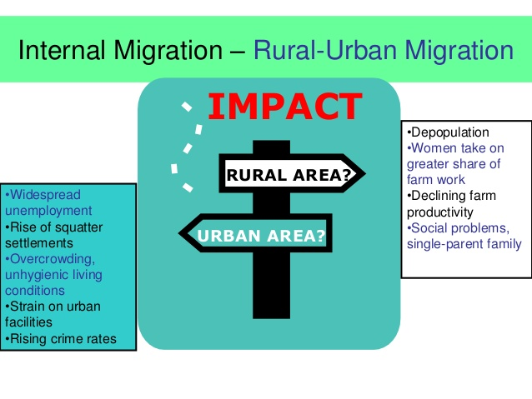

Slide 13
Negative Impacts of Rural-Urban Migration
Pollutions
Traffic Jam
Slum Dwelling/Squatter settlement
Poor housing and sanitation
Health and nutrition problem
Growth of Informal Job sector
Lack of facilities like water, electricity and gas
Lack of Education for migrated people
Urban Poverty
Unemployment
Increased Crime rate

Slide 14
Dhaka's Primacy
The primacy of Dhaka, which is highly associated with centralised governance of the country, is overwhelming. The capital hosts 28 percent of the country's urban population and 25 percent of economic activities employing 35 percent of the total urban labour force.
A primate city generally dominates over other cities literary in all aspects - politics, economy, media, culture and education, inter alia. According to urban economists, unitary governments generally favour the national capital, creating a primate city bias in public services and infrastructure investments, among others. Rent seeking and urban bias by central government bureaucrats result in the centralisation. This favouritism draws in immigrants. However, according to a World Bank study, the degree of urban concentration in Bangladesh is higher than many of its comparators with Dhaka's primacy rate being 32 percent, which is much higher than its optimal (21 percent) level.
Finally, excessive urban concentration leads to degradation of the quality of life owing to congestion, contamination of ground water and poor air quality, among others.

Slide 15
Dhaka's Primacy
The next point to ponder is how to break the urban primacy of Dhaka? Experience suggests that in developing countries, urban concentration increases in the early stages of economic development. Thus, part of the problem is structural. In fact, most developing countries have witnessed the rise of primate cities- Bangkok in Thailand, Jakarta in Indonesia, Manila in the Philippines and Colombo of Sri Lanka are some examples of primate cities. But their concentration varies widely. Nevertheless, there are numerous ways to lessen urban primacy.
Externalities such as congestion or pollution arises from higher population density should be priced (through tax and other measures). This could lead to de-concentration. The lack of pricing or ineffective regulation means that immigration into the capital city is underpriced or subsidised.
Investment in modern intercity transport and communications may prompt urban de-concentration as manufactures could locate their firms in hinterlands.
Globalisation could also help reduce urban primacy, provided trade and other reforms are carried out. The literature on new economic geography predicts that a country's exposure to trade may encourage hinterland development.

Slide 16
Dhaka's Primacy
Finally, local political and fiscal autonomy could help in reducing urban primacy. Studies indicate that the key to a successful local political process is local participation in political processes (voting outside the influence of the central government and reasonably unconstrained by national-level party officials) and local determination of revenues and expenditure levels.
That said, history is full of evidences that over-concentration of political and economic power, often in the capital, leads to the fall of many kingdoms, empires and states. Citing the example of Pax Romana, urban economists discourage over concentration of power in capital cities. Rome used its political and military might to suppress potential competitors to its rule and to extract resources from its empire. The result was that the parasitic character of the Roman metropolis was not only responsible for a weakening of the Italian economy, it also played a central role in the collapse of the empire.
The outcome of power concentration is no different in other instances- Pharaonic Egypt and the Ming dynasty in China tightened the reins after, not before, they prospered, but this could not save their collapse. Dhaka seems to be following the same path. Taking lessons from history, the government should act now and show its commitment toward decentralised governance.
Source: M Shahidul Islam ,The Daily Star Friday, March 27, 2020

Slide 17
How to manage/reduce Internal Migration in Bangladesh
By decentralizing infrastructure, industrial activities, public services, and administrative functions, as well as divelting investment from Dhaka City towards small towns and villages, rural urban migration in Dhaka City can be reduced.
Decentralization
(Population distribution, creating education, health, job facilities in other cities, )
Rural development
Self Employment
Improving the condition of the Informal job sector
Create Urban hubs and encourage settlement in growth area to help absorb migrants
Develop peri-urban areas with improved transportation for migrant populations. This policy would ease pressure on slums and squatter settlements, as well as on amenities like sanitation

Slide 18
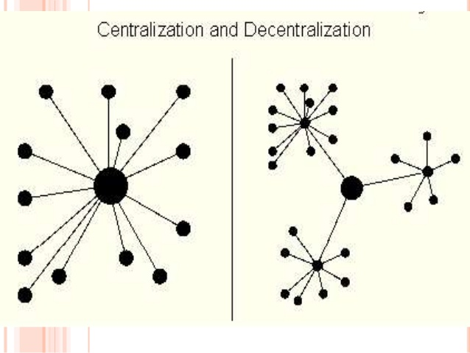

Slide 19
How to manage/reduce Internal Migration in Bangladesh
Urban decentralization through promotion of new locations in non-metropolitan areas can playa vital role in moulding migration flows and national settlement pattern. To be more specific, this refers to the promotion of locations, mainly rural market centres, to small rural towns. It assumes that small towns within a self-reliant territorial unit can promote rural development through greater local control over resources complementary urban-rural linkages and decision making at the local level.
The approach suggests measures such as rural industrialization, diversification of agriculture, retention of surpluses at the local level, comprehensive land reform, introducing and adopting the key elements of urbanism to specific rural setting (Friedman and Dauglass 1978: Douglass1992). It was found that such industrial and urban decentralization strategies had been fairly successful in Republic of Korea, Cuba, Poland, India, Malaysia,Tanzania and Japan (Simmon's 1979 and Oberai, 1987).

Slide 20
How to manage/reduce Internal Migration in Bangladesh
Instead of allowing the prevailing urban centers to be bear the burnt of migration it is necessary to develop small urban centers in the form of Compact Townships that would not only absorb willing migrants but also encourage other rural households to move to these Compact Towns. Similar concept had been used in other countries like Germany and Srilanka.

Slide 21
How to manage/reduce Internal Migration in Bangladesh
The new industries should be established in middle-sized towns, small towns, or new locations selected on account of the accessibility of raw materials or other considerations.
In the light of Todaro model (1976) it can be recommended that imbalances in urban-rural employment opportunities need to be reduced. By creating and increasing wage rate in different area or less populated area, population can redistribute or rural urban migration can reduce.

Slide 22
How to manage/reduce Internal Migration in Bangladesh
The government may be redistributing population from thickly Populated areas to sparsely populated areas.
Subsidies and tax incentives may be provided only for offices, factories of industries which will be out of Dhaka City.

Slide 23
How to manage/reduce Internal Migration in Bangladesh
By increasing economic opportunities in rural areas through, e.g. promotion of small labour intensive industries and minor public works. Rural off-farm development also helps to satisfy the basic needs and practical ambitions of rural
residents and hence reduce rural urban migration in Dhaka City.

